Slide 1
GSA Advantage!®
The Basics
2023 GSA SmartPay Virtual Training Forum June 13-15, 2023 Presenter: Tausha Freeman

Slide 2
Agenda
Homepage Functionality
Registration/Login
Homepage Features
Search Capabilities
Checkout Process

Slide 3
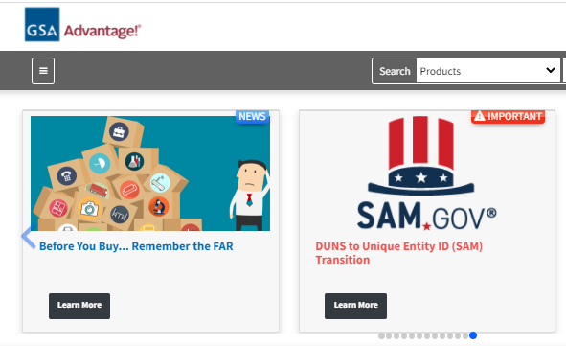
What is GSA Advantage!
Online Product Superstore opened in 1994:
Hosts orderable products and vendors catalogues
Store your profile and payment information
Ideal for conducting market research
Notes:
This slide is displaying how GSA Advantage used to look like in early 2020.

Slide 4
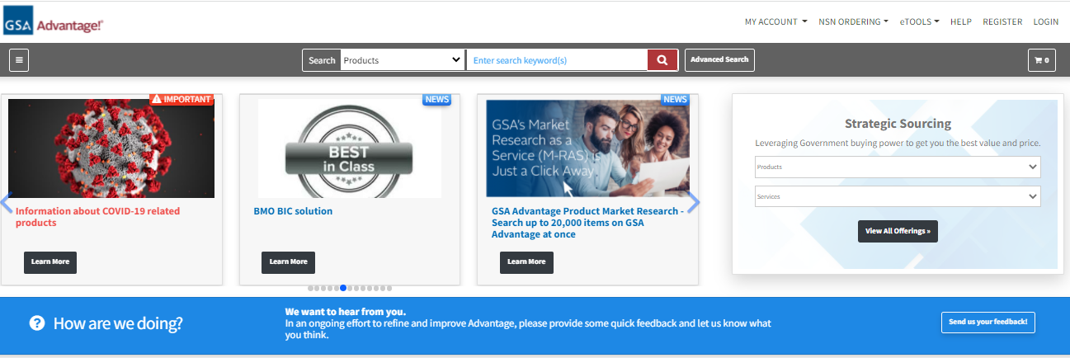
Homepage/Functionality
Notes:
From this slide, you can see that GSA Advantage has undergo a significant User Interface upgrade to make it friendly for all users.

Slide 5
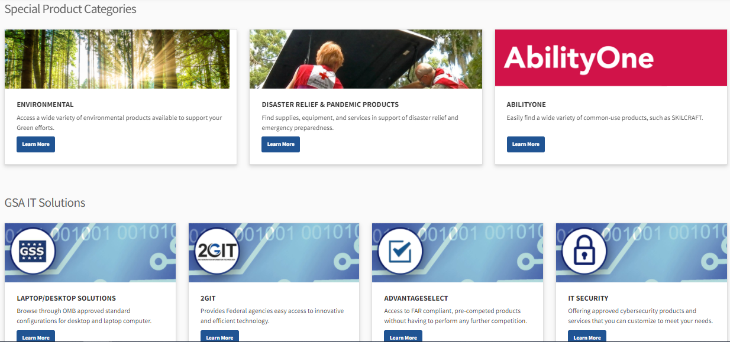
Homepage/Functionality (Continued)
Notes:
You can tell by these screenshots of Special Product Categories section and GSA IT solutions section that the new GSA Advantage is very user friendly.
Don’t worry, we will briefly go over these sections in this presentation.

Slide 6
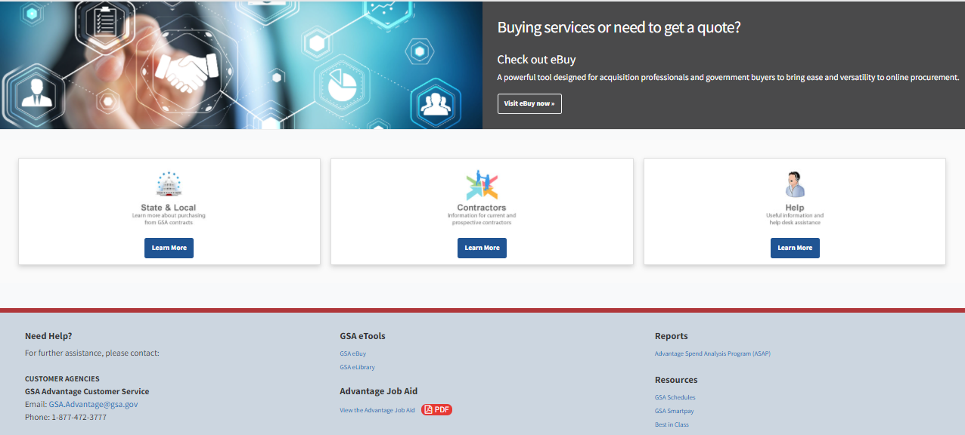
Homepage/Functionality (Continued)
Notes:
As well, you see from the screenshots the eBuy links, very useful title, and the footers with points of contacts.

Slide 7
Registration/Login
Register
Multi Factor Authentication (MFA) Registration
PIV/CAC Registration

Slide 8
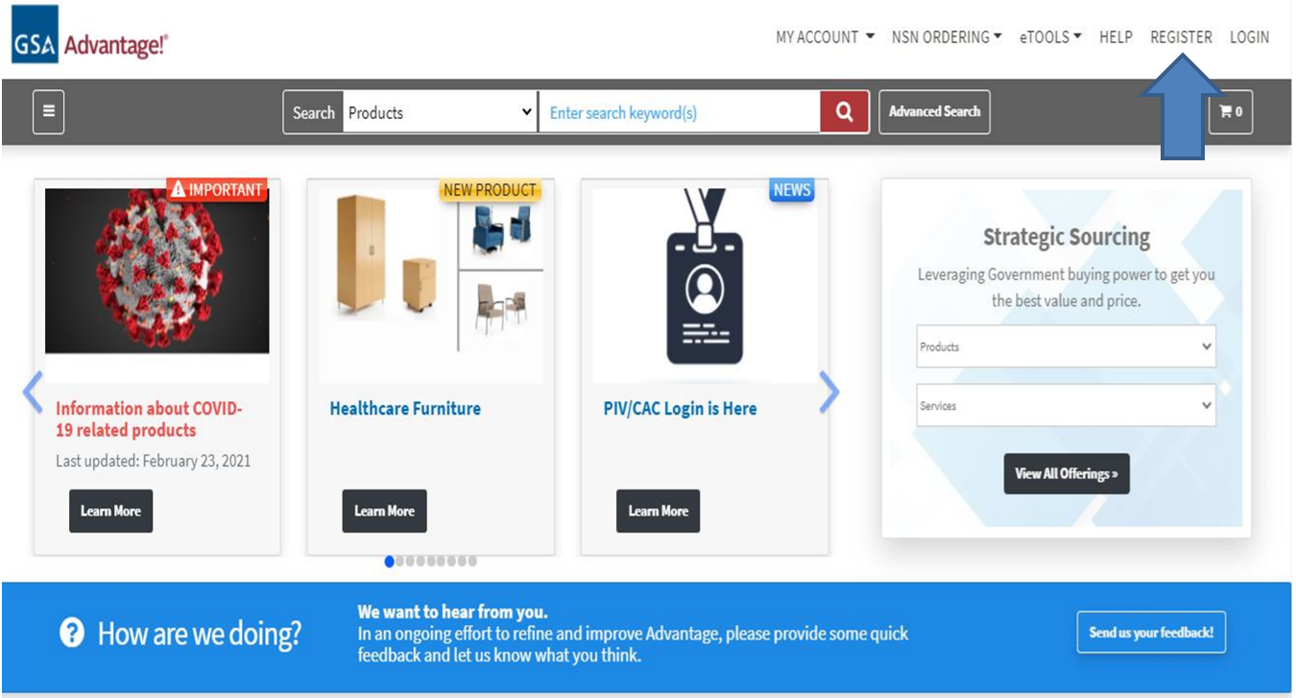
Homepage/Register

Slide 9
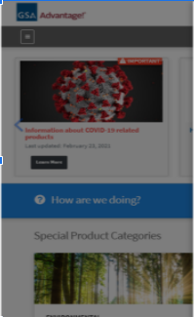
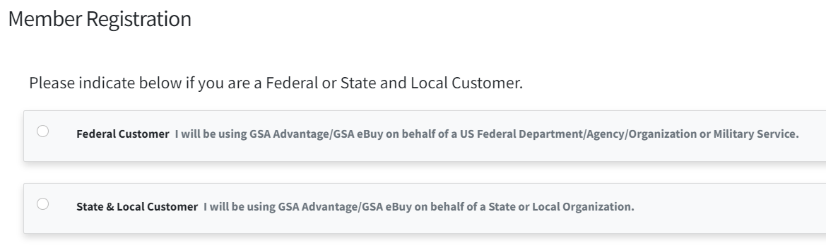
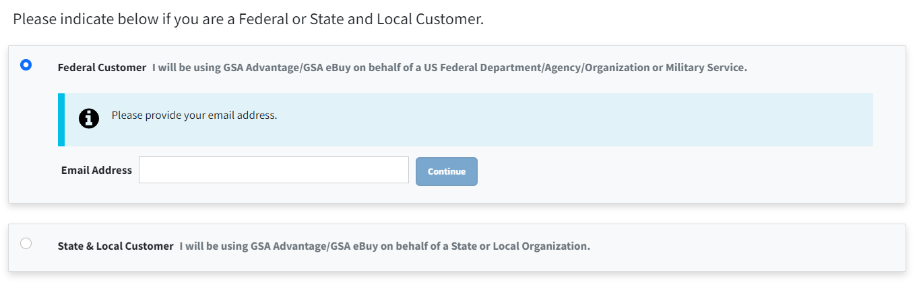
Homepage/Register

Slide 10
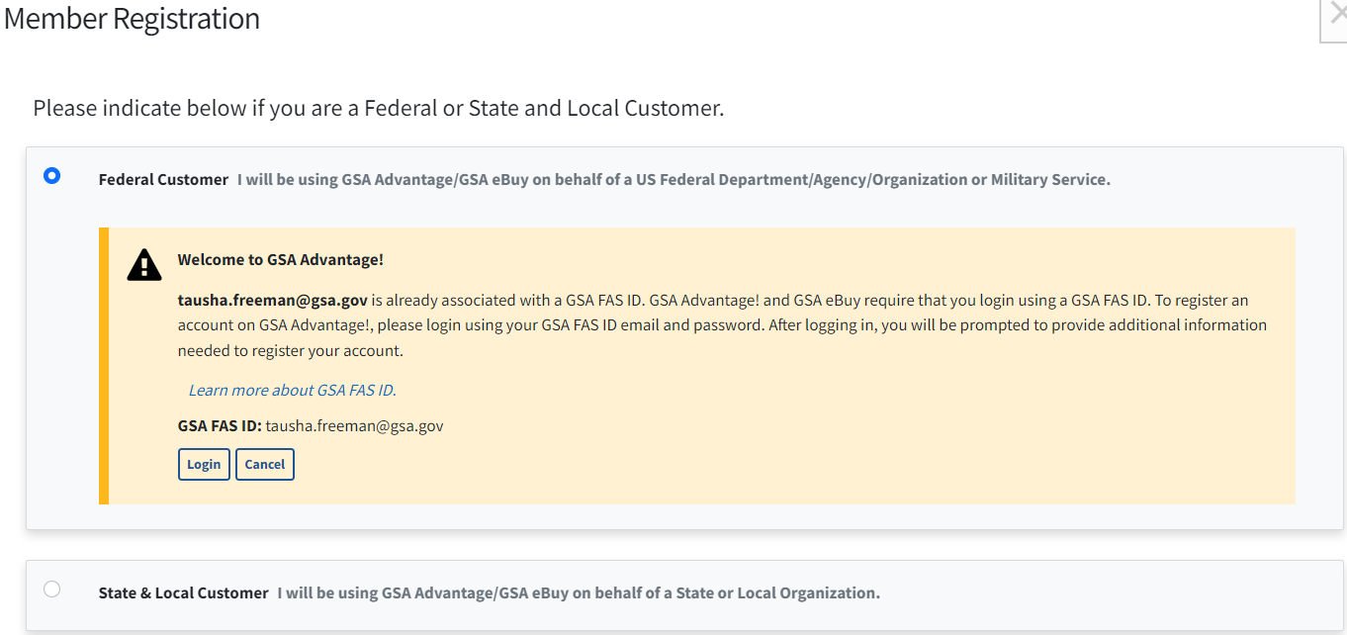
Homepage/Registration (Existing User)

Slide 11
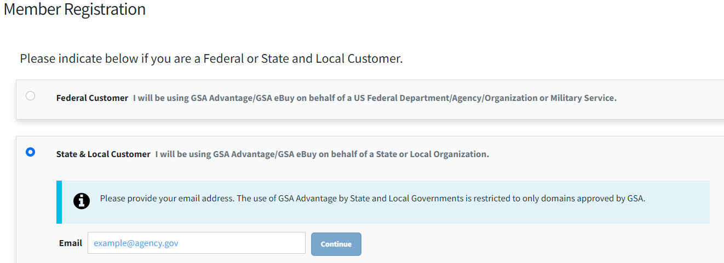
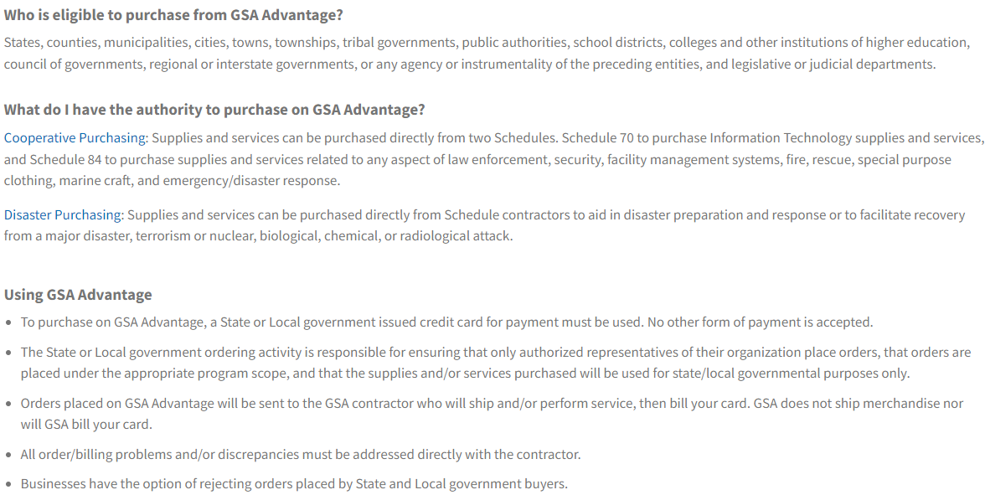
Homepage/Register

Slide 12
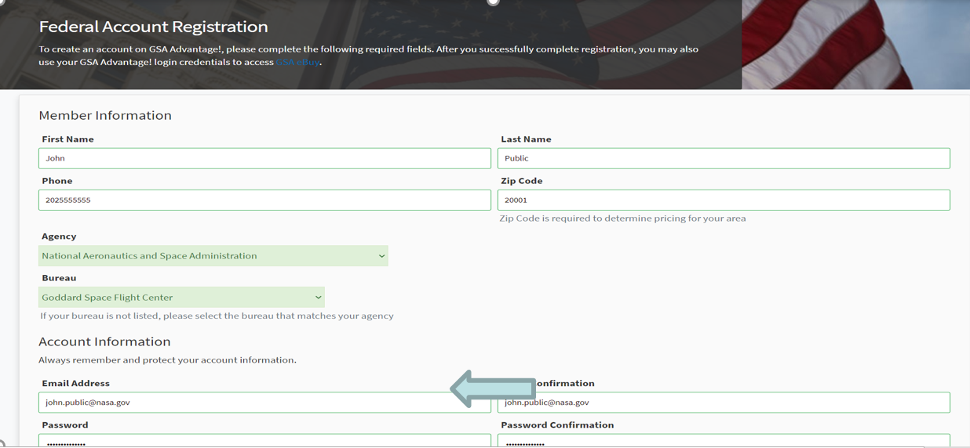
Homepage/Registration (New Users)

Slide 13
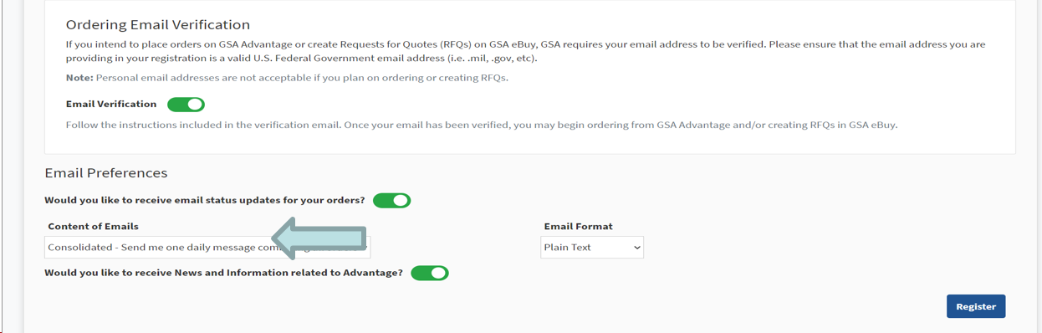
Homepage/Registration Continued (New Users)

Slide 14
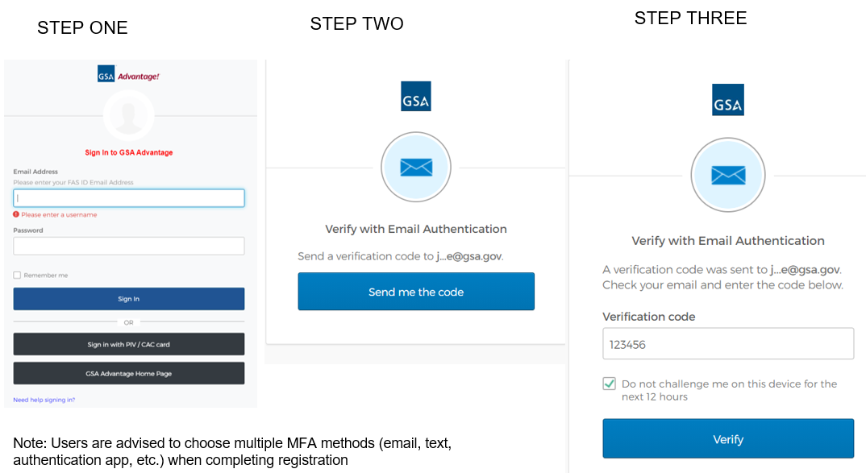
Homepage/Registration/MFA (New Users)

Slide 15
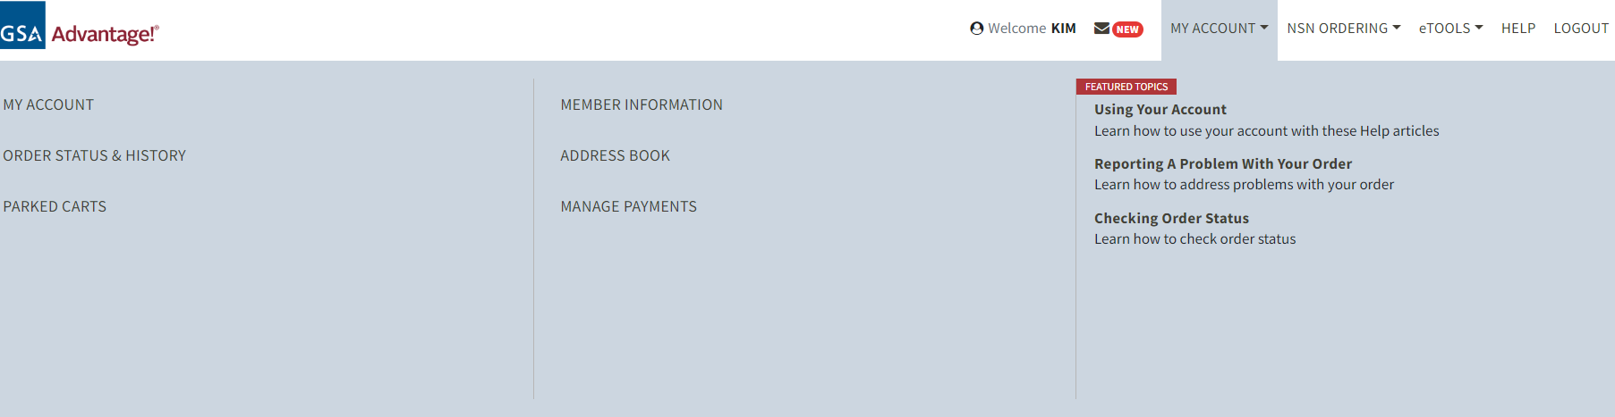
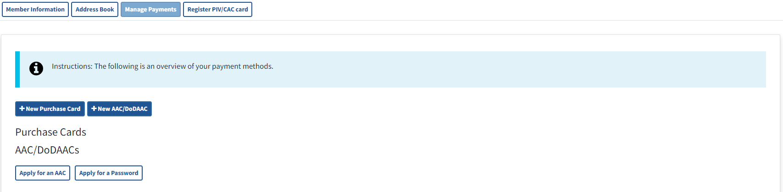
Homepage/PIV-CAC Registration (New Users)

Slide 16
Homepage Functionality
Static Links
My Account
NSN Ordering
eTools
Help
Notes:
Lets begin with Static links that is located at the top right corner of GSA Advantage page.

Slide 17
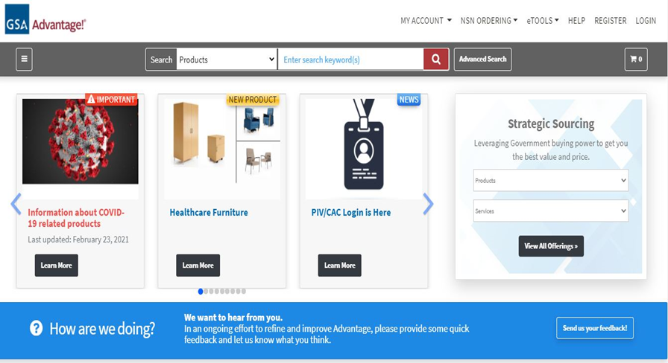
Homepage/Static Links
Notes:
Lets begin with Static links that is located at the top right corner of GSA Advantage page.

Slide 18
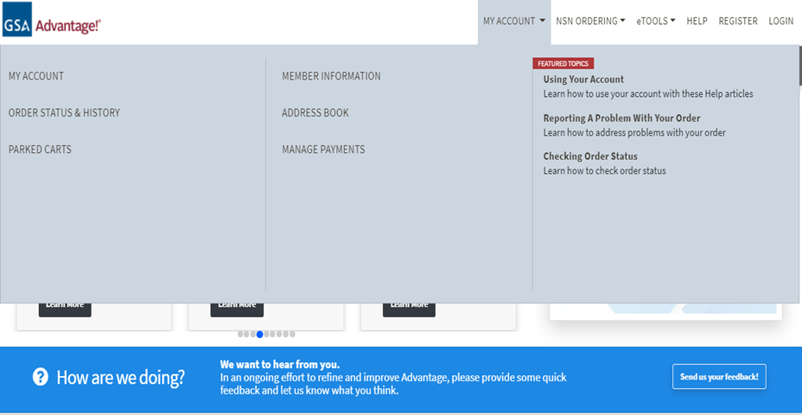
Homepage/My Account

Slide 19

Homepage/NSN Ordering

Slide 20
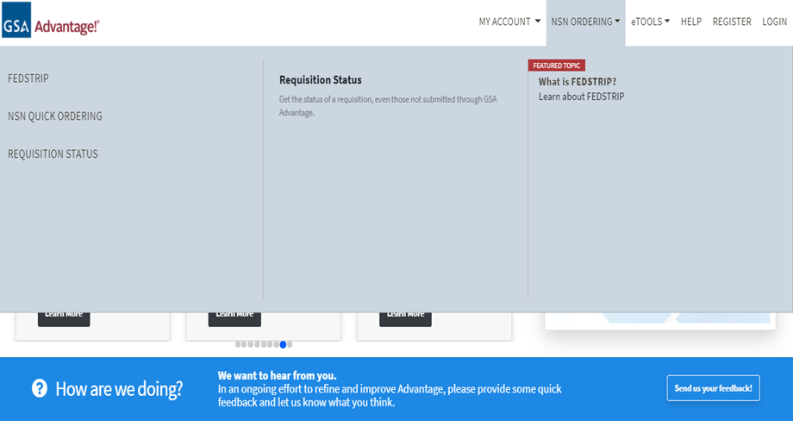
Homepage/NSN Ordering

Slide 21
Homepage/eTools

Slide 22
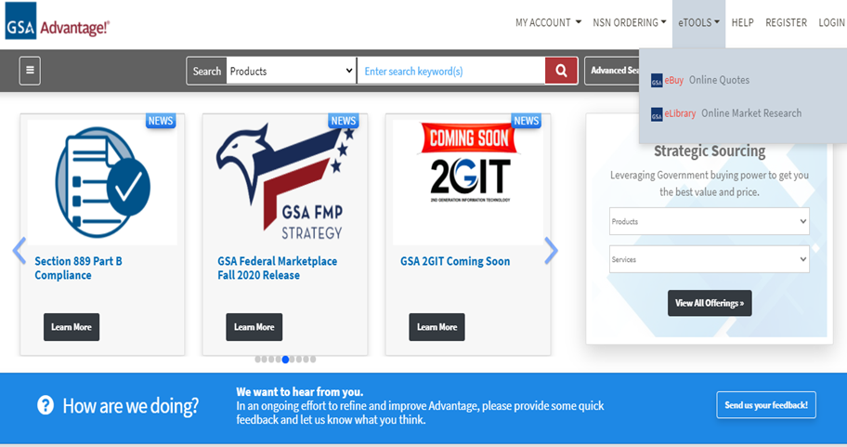
Homepage/eTools Dropdown Links

Slide 23
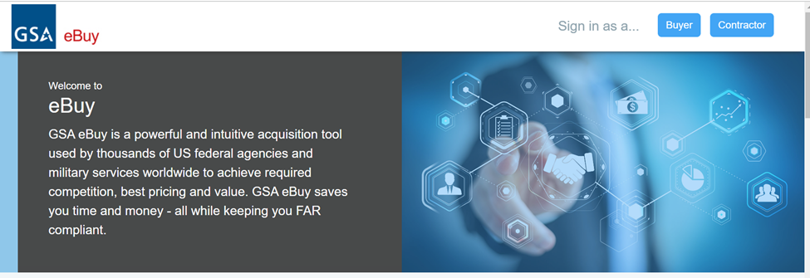
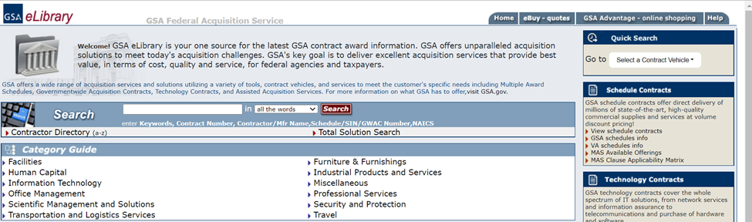
Homepage/eTools Dropdown Links

Slide 24
Homepage/Help

Slide 25
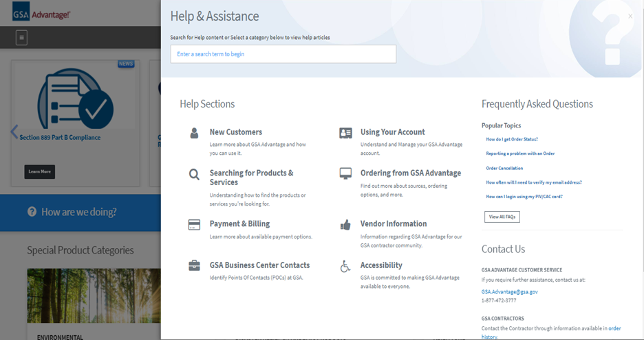
Homepage/Help & Assistance

Slide 26
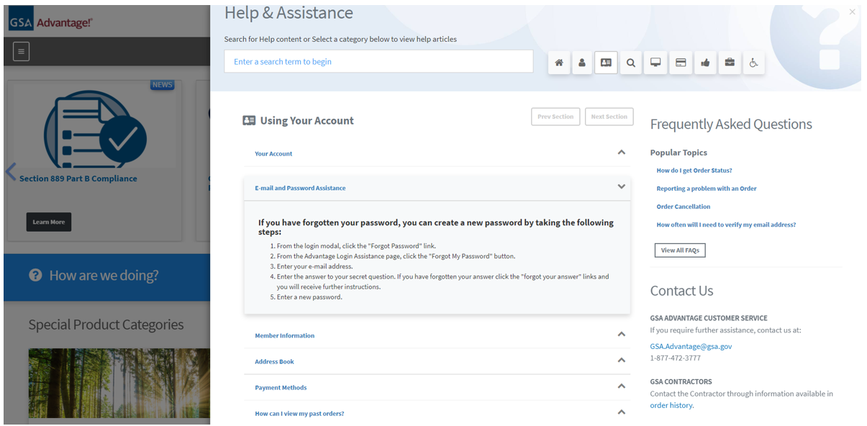
Homepage/Help & Assistance (Continued)

Slide 27
Homepage/Features
Browse Categories
News
Strategic Sourcing
Special Product Categories
GSA IT Solutions
eBuy
Help
Footer

Slide 28
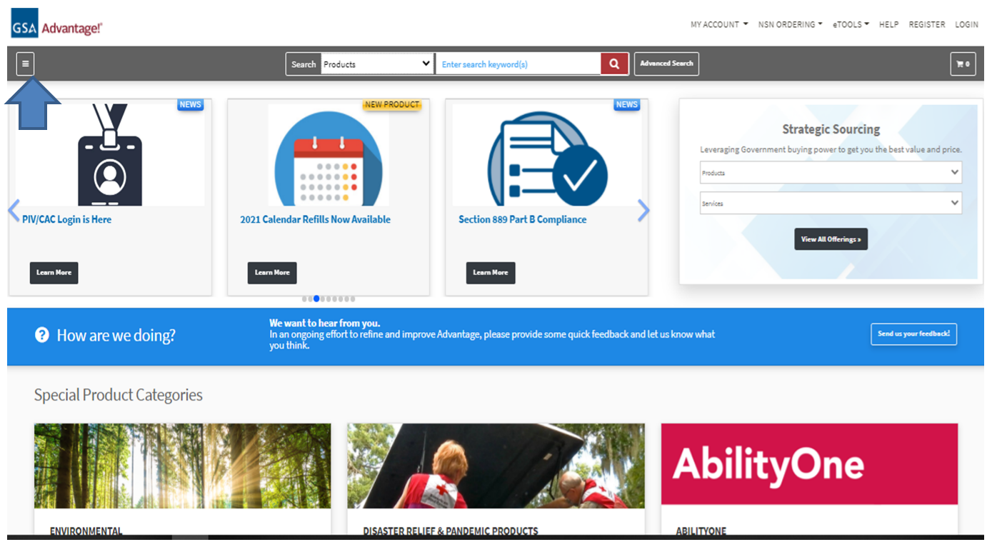
Homepage/Browse Categories

Slide 29
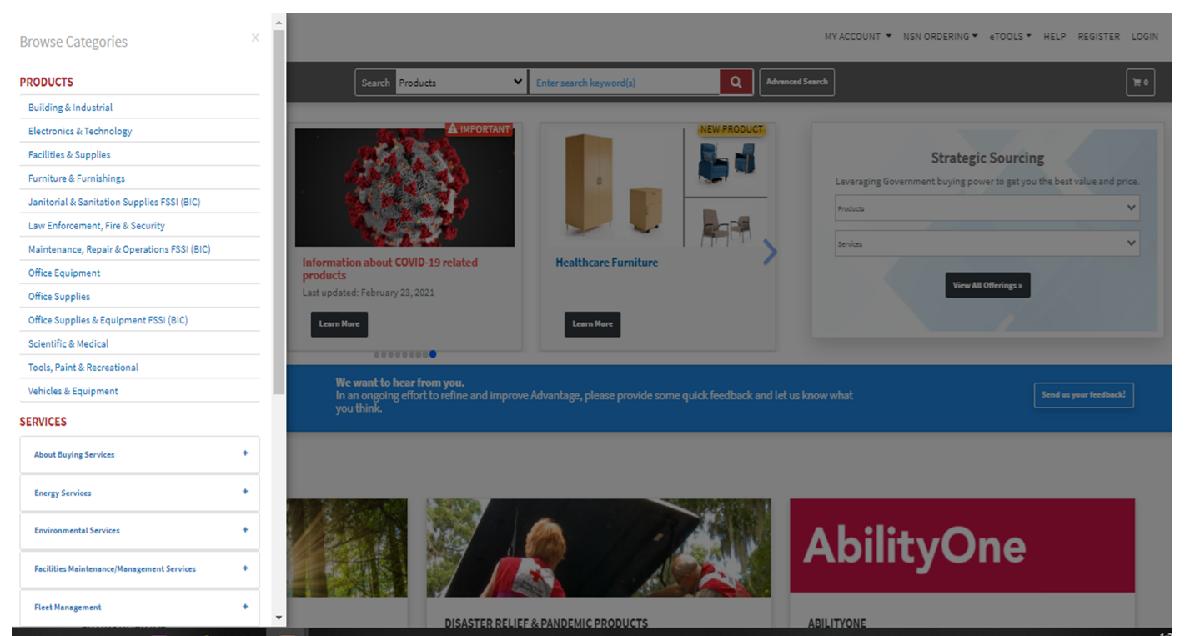
Homepage/Browse Categories

Slide 30
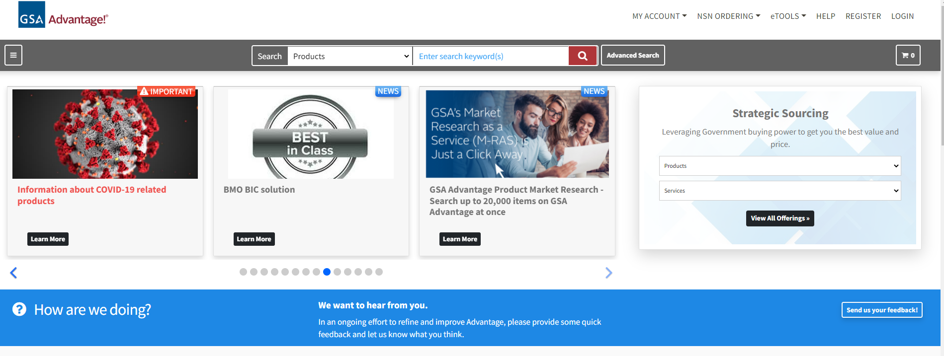
Homepage/News

Slide 31
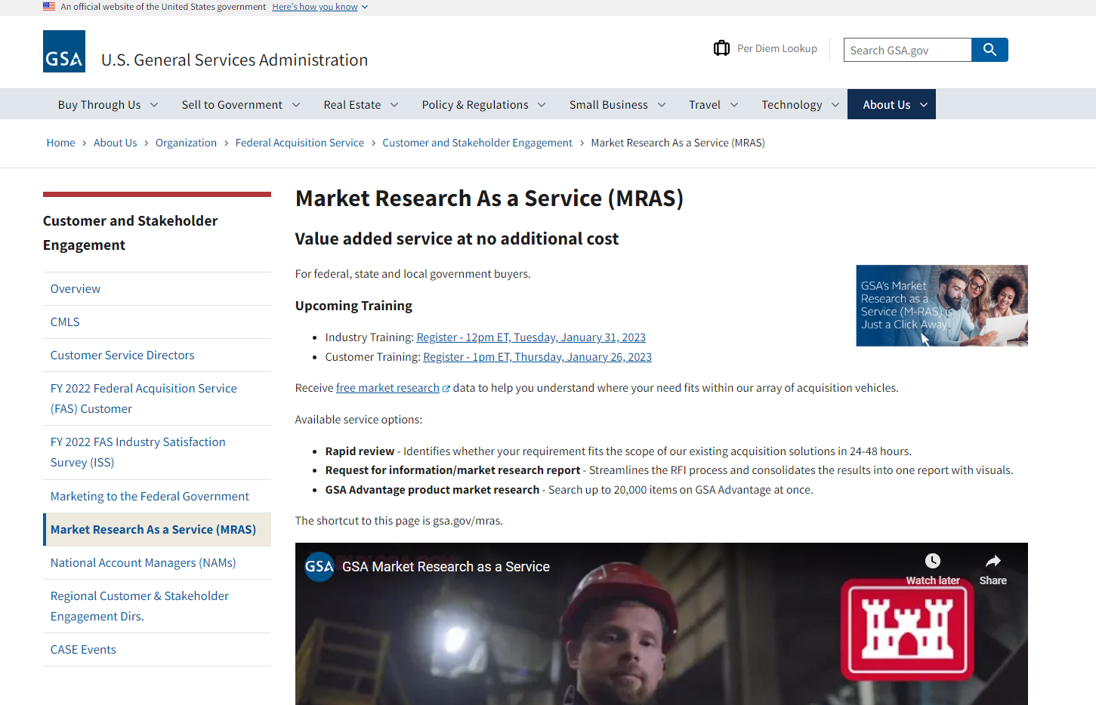
Homepage/News

Slide 32
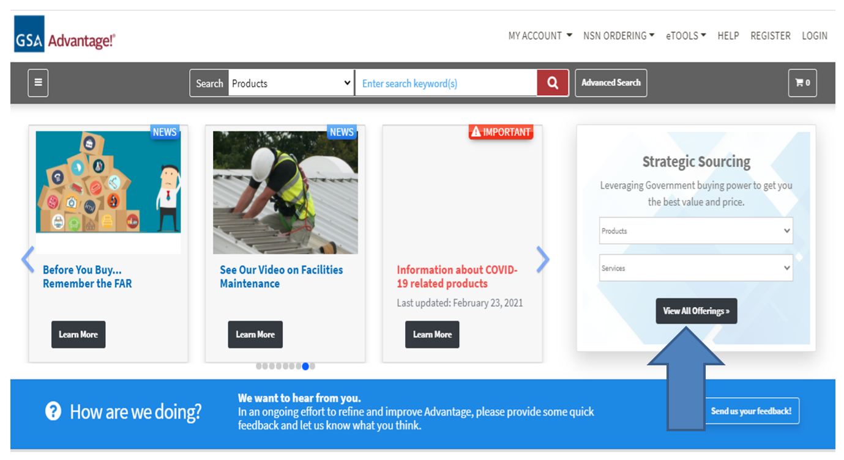
Homepage/Strategic Sourcing

Slide 33
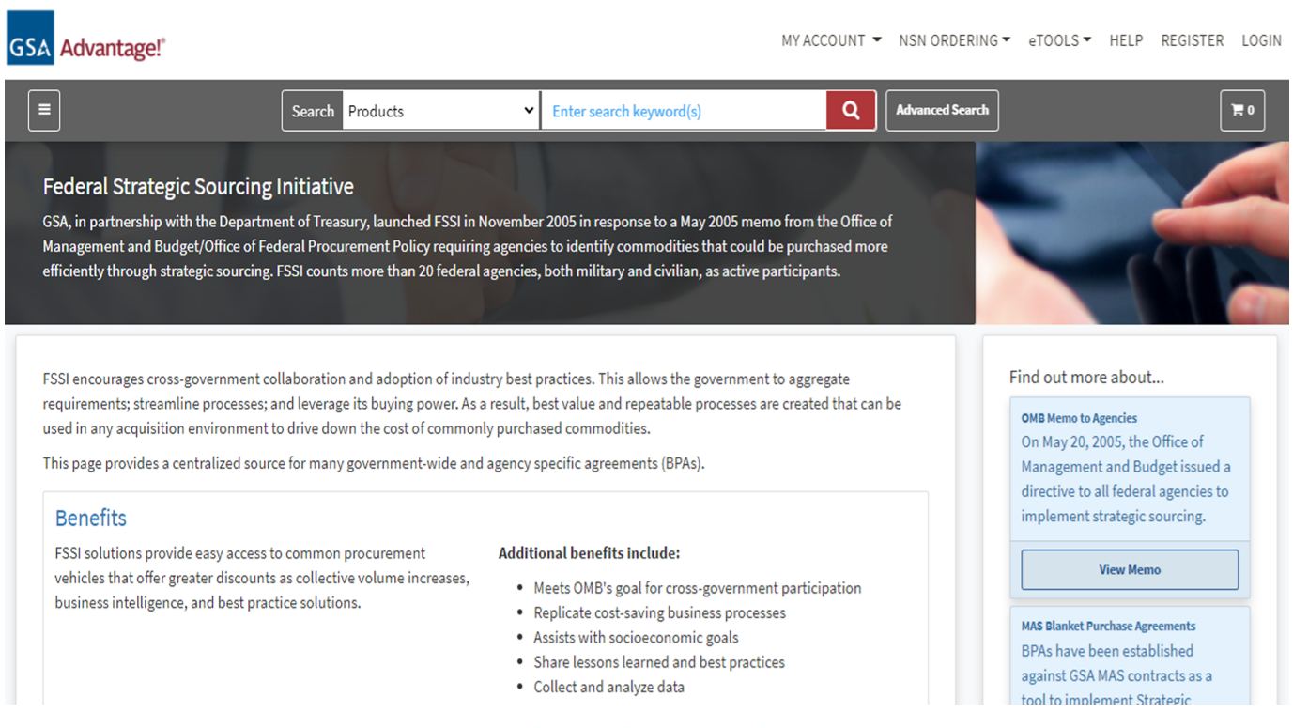
Homepage/Strategic Sourcing

Slide 34
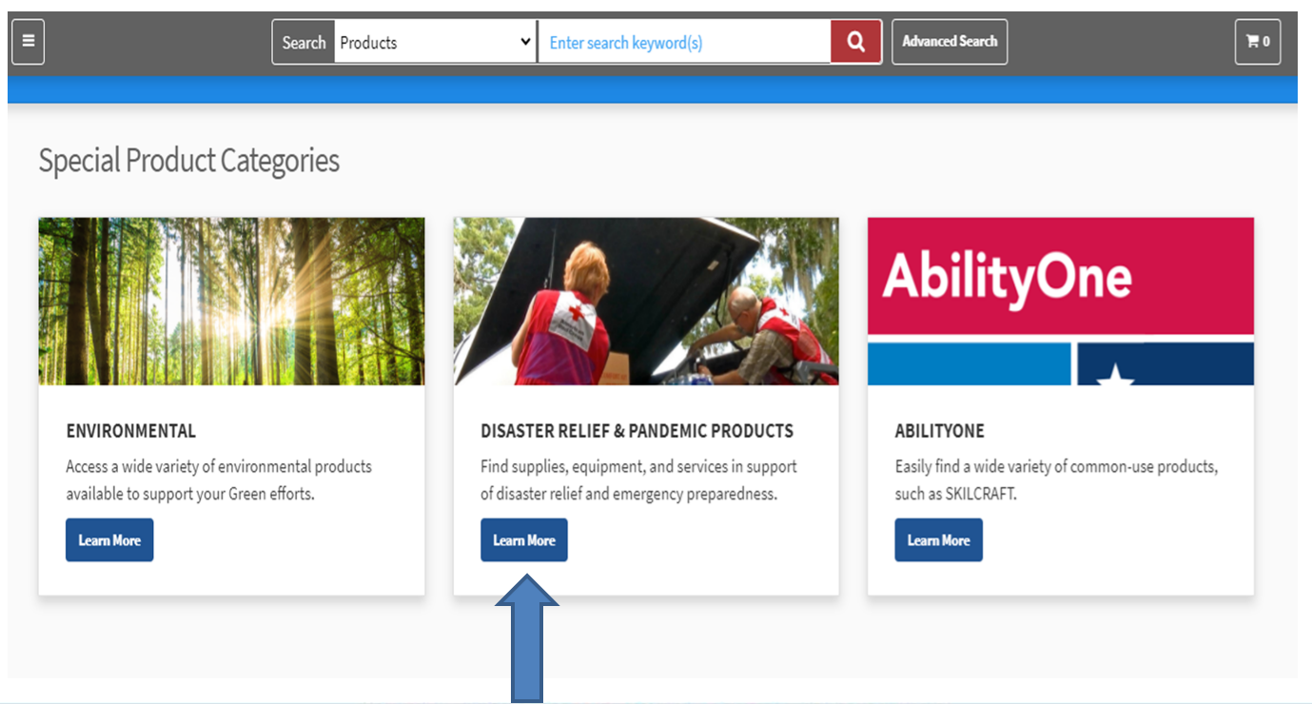
Homepage/Special Product Categories

Slide 35
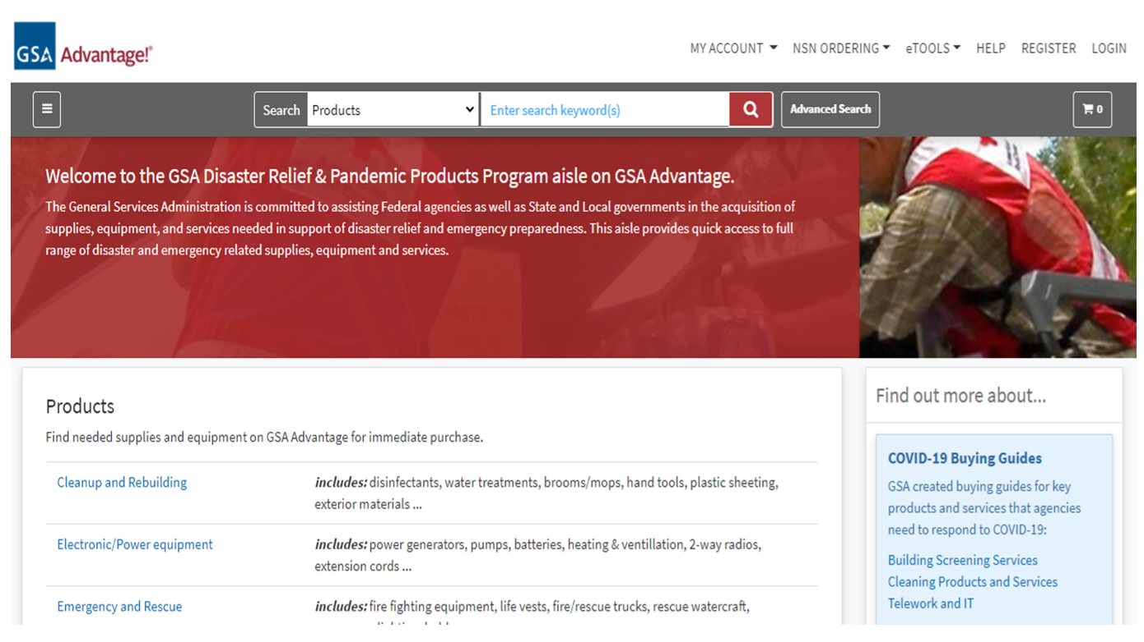
Disaster Relief Page

Slide 36
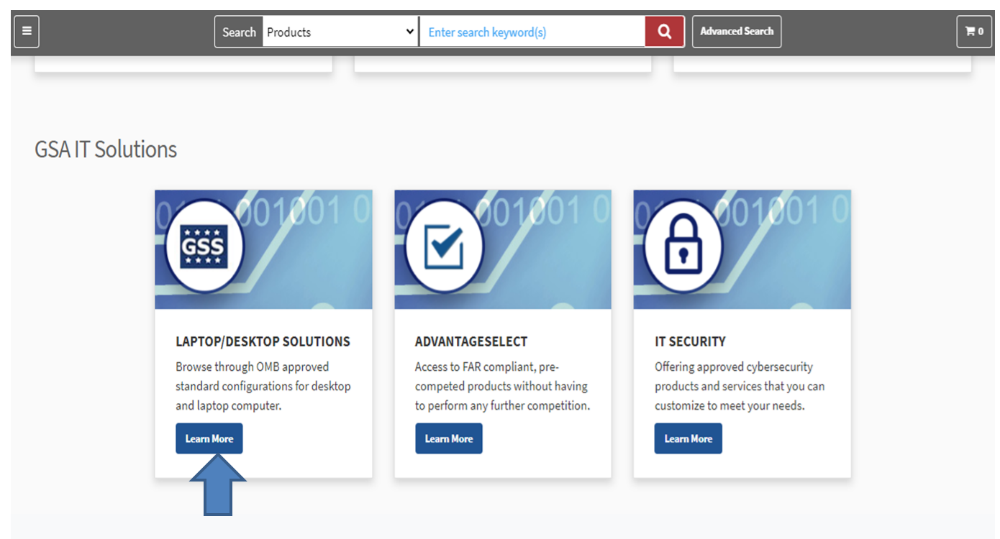
Homepage/GSA IT Solutions

Slide 37
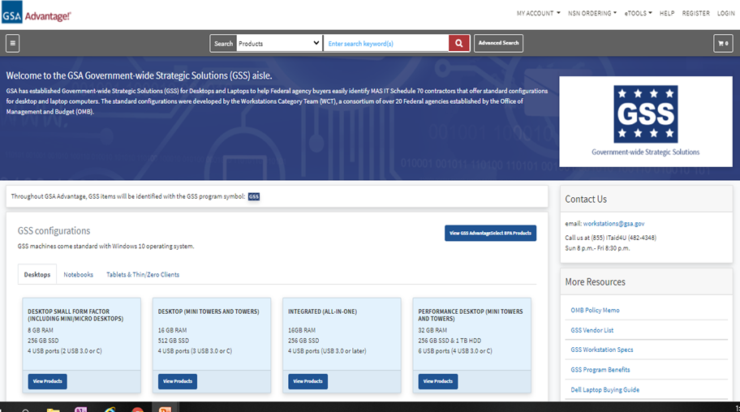
Laptop/Desktop Page

Slide 38
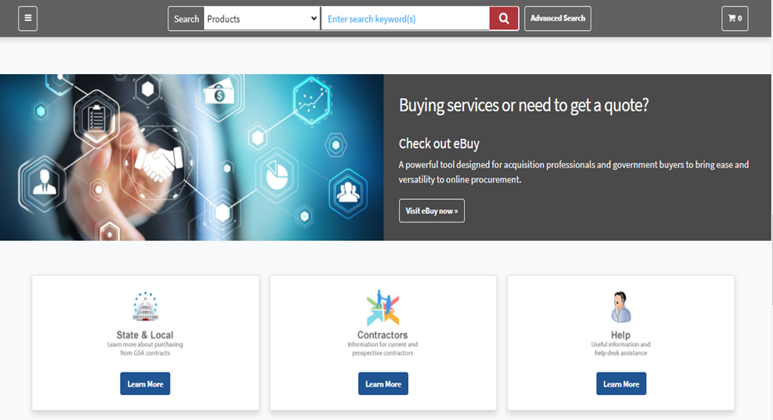
Homepage/eBuy

Slide 39
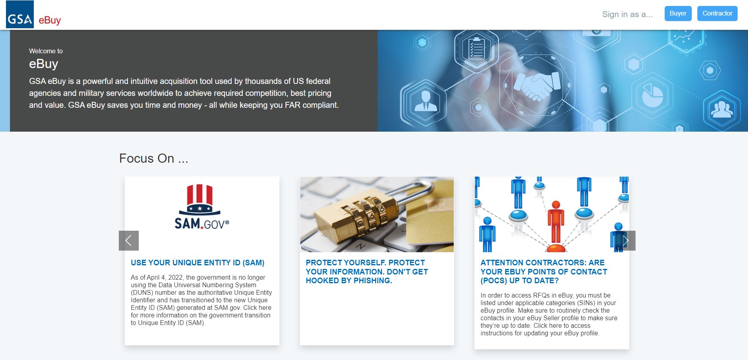
Homepage/eBuy

Slide 40
Homepage/State & Local/Contractors/Help

Slide 41
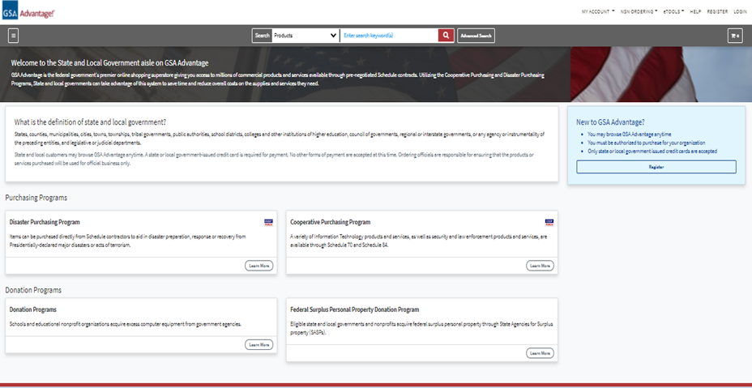
State & Local Page

Slide 42
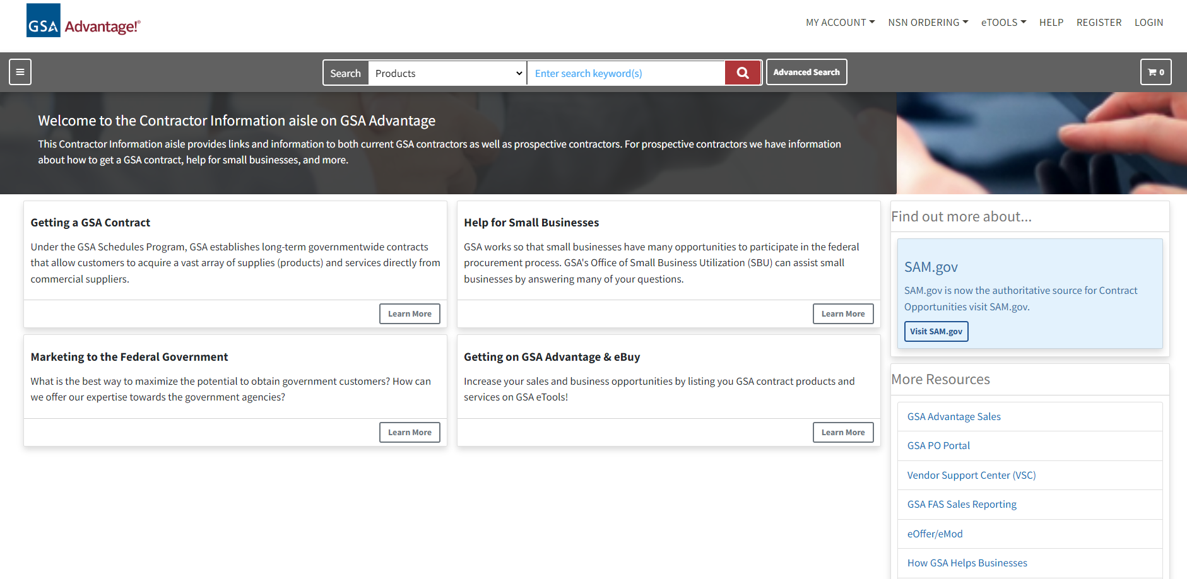
Contractor Page

Slide 43
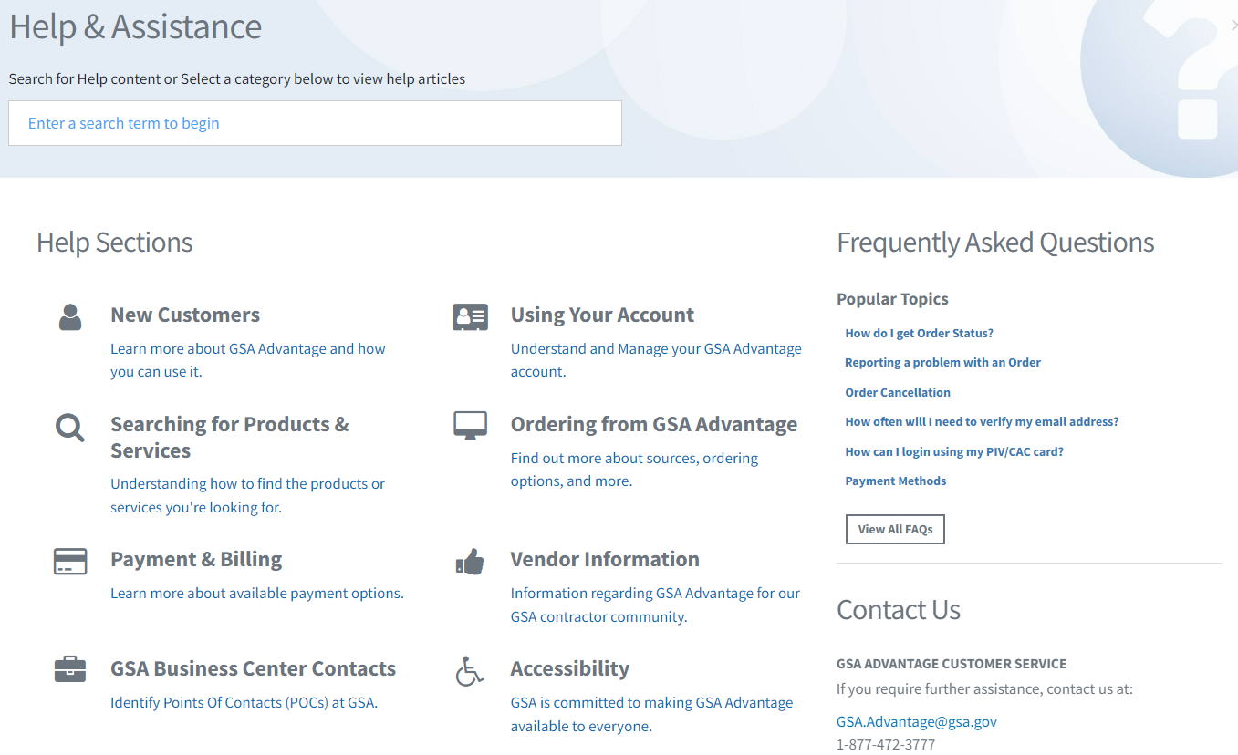
Help & Assistance Page

Slide 44
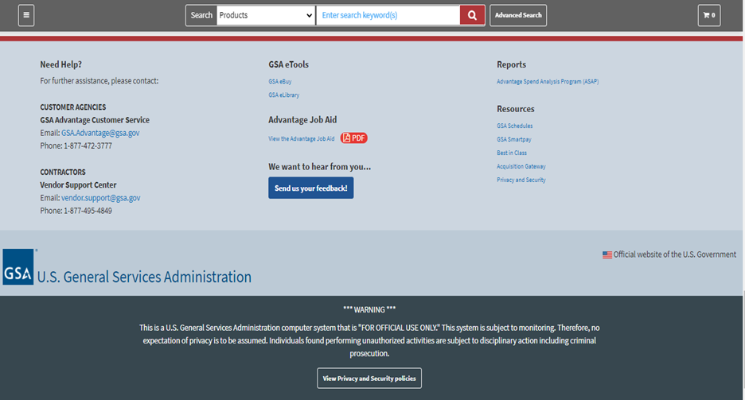
Homepage/Footer

Slide 45
Search Capabilities
Product Search
Result Page
Product Details/Sources

Slide 46
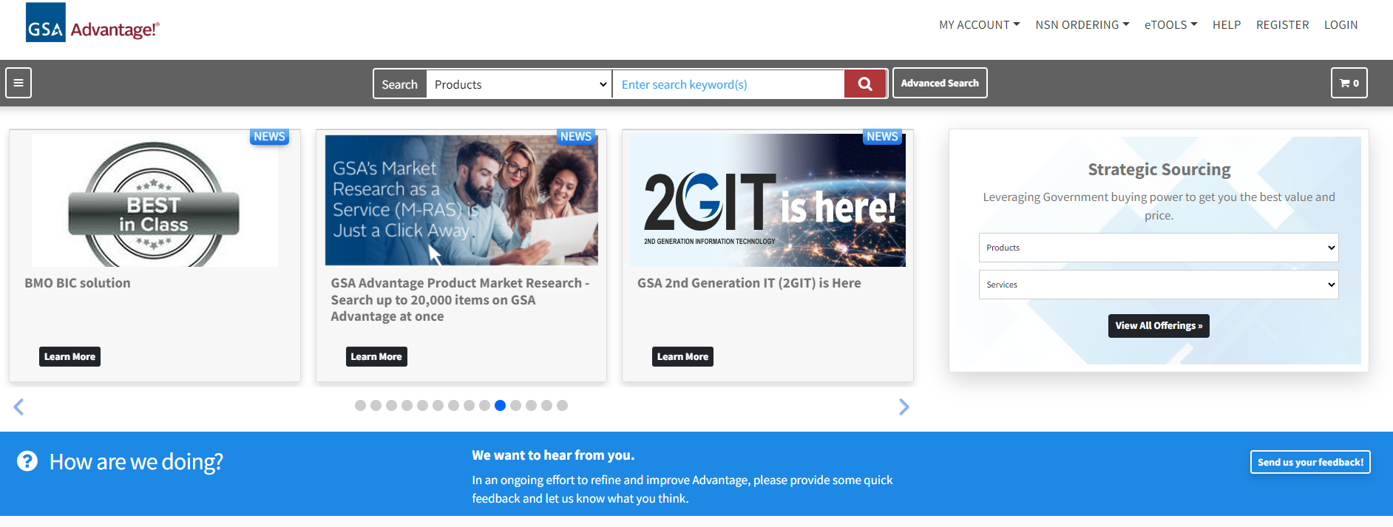
Homepage/Search Box

Slide 47
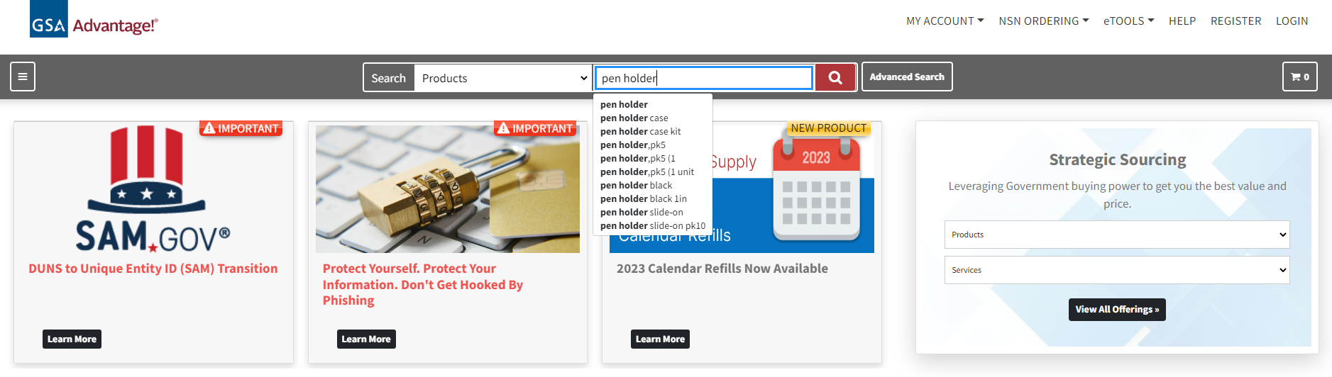
Homepage/Search Results - Standard

Slide 48
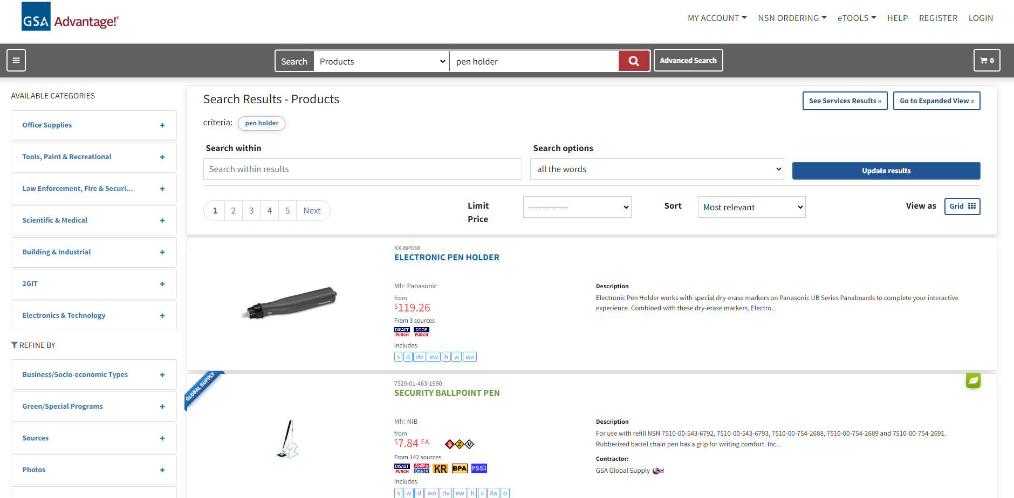
Homepage/Search Results - Filter by Categories Page

Slide 49
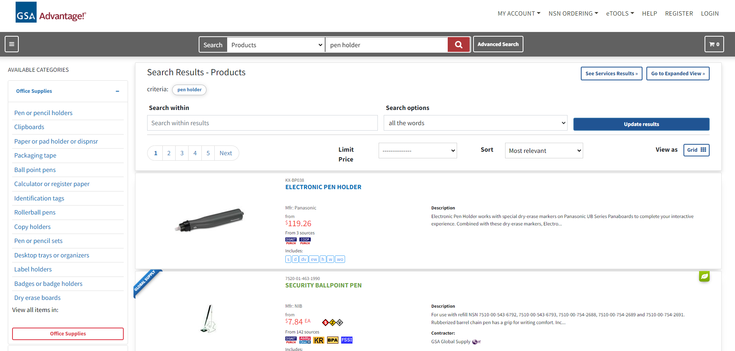
Homepage/Search Results - Filter by Categories Page

Slide 50
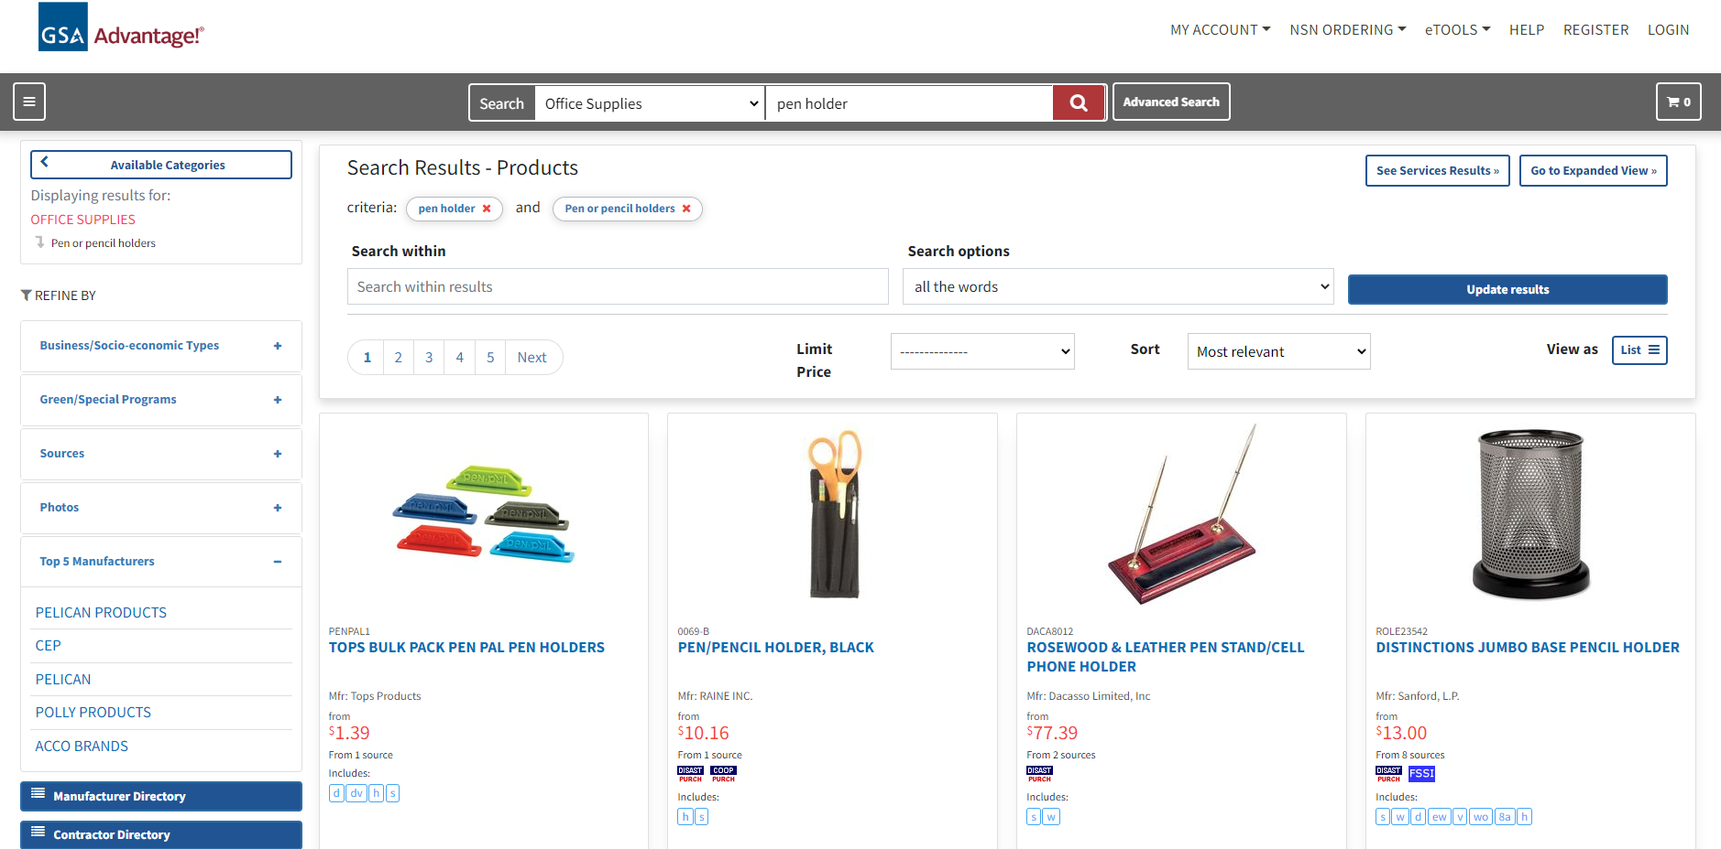
Homepage/Search Results - Filter by Categories Page

Slide 51
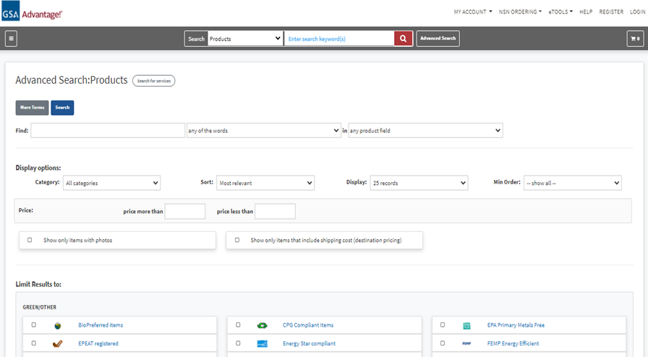
Homepage/Advanced Search Box Page

Slide 52
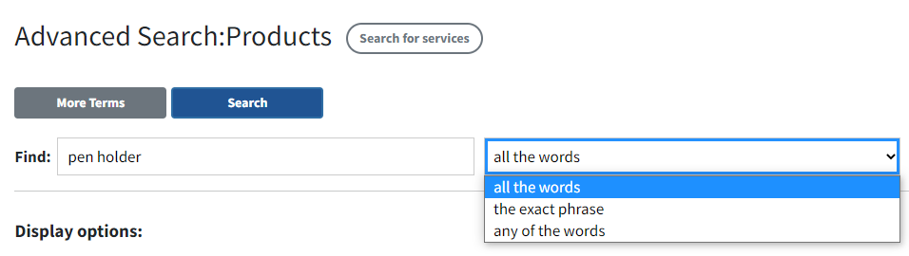
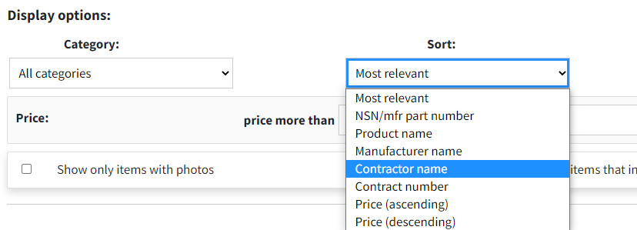
Homepage/Advanced Search Box Page

Slide 53
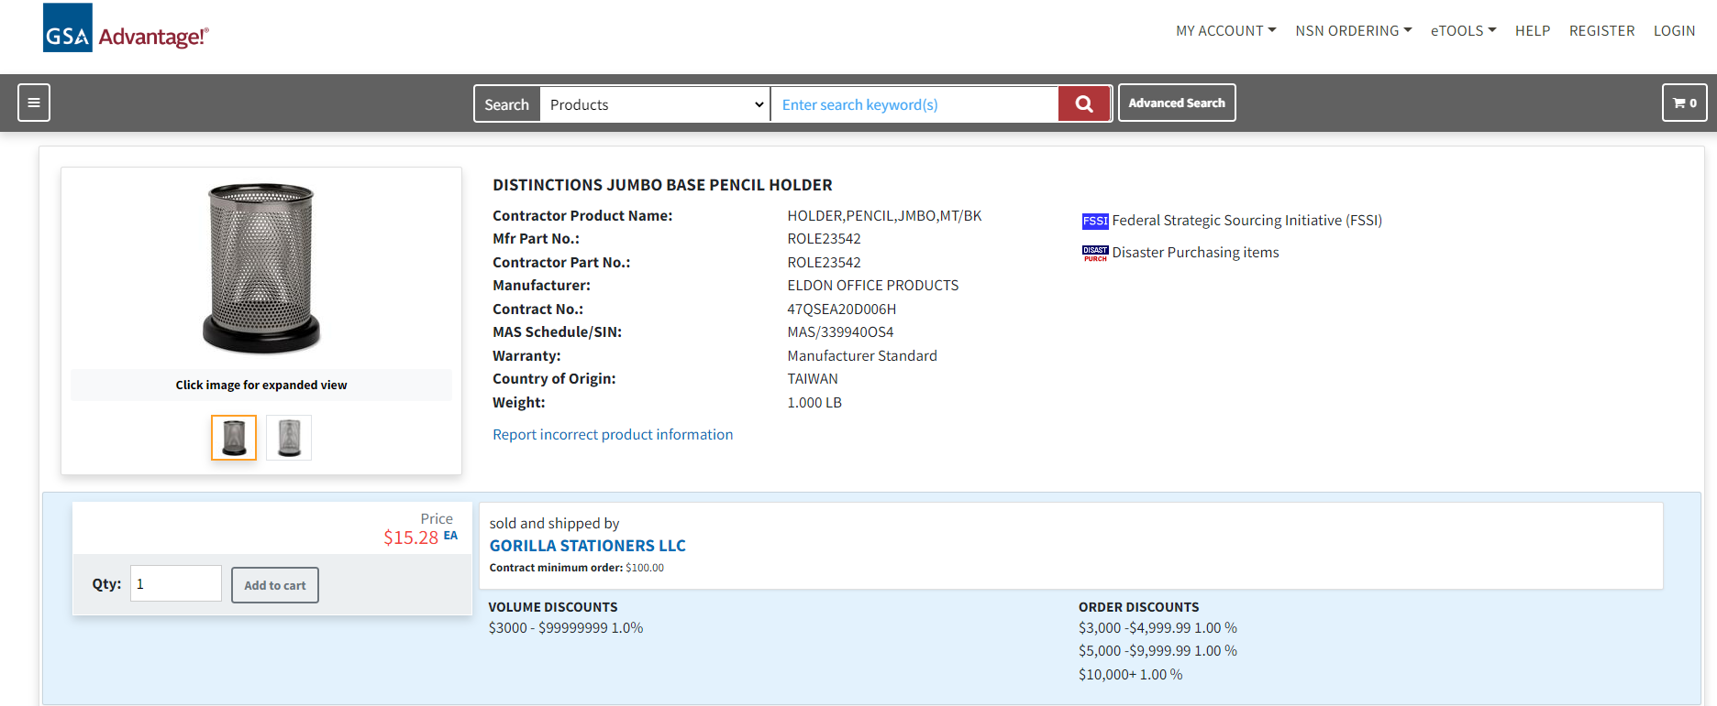
Pen Holder

Slide 54
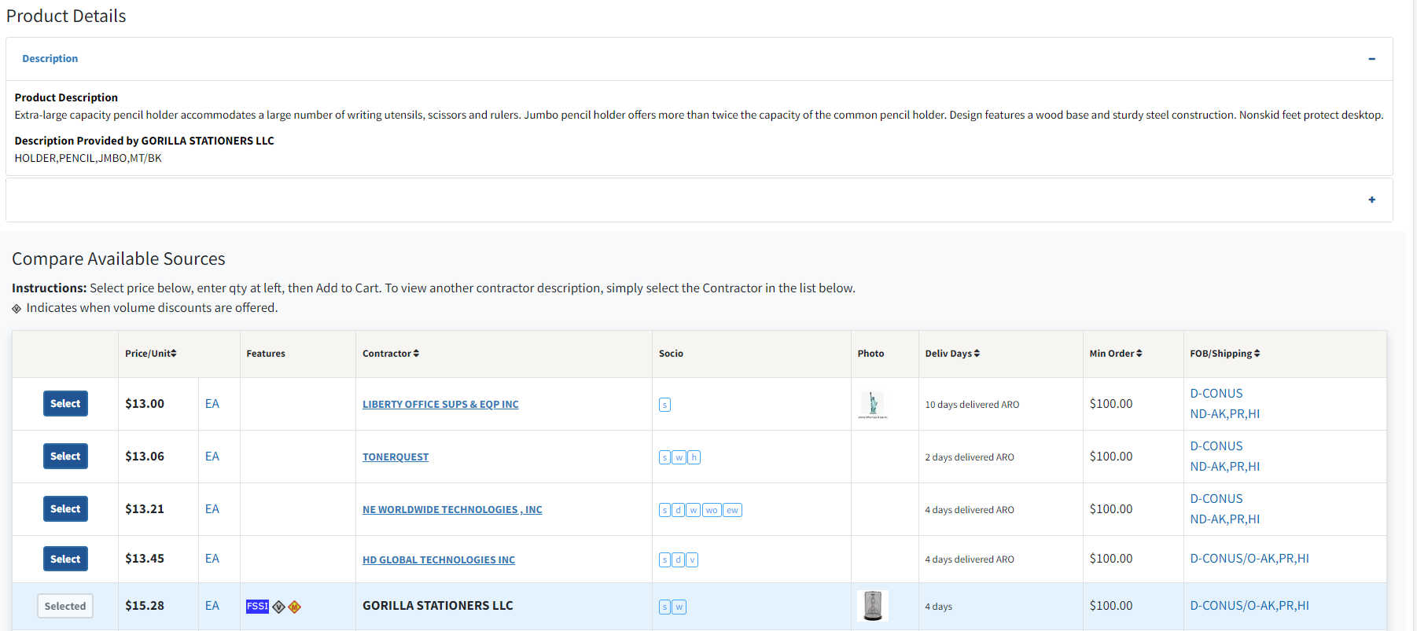
Product Details/Sources

Slide 55
Checkout Process
Shopping Cart
Parking Cart
Forward Cart
Review Order/Checkout
Manage Payment/Address
Access Order History

Slide 56

Homepage/Shopping Cart

Slide 57

Homepage/Shopping Cart Page

Slide 58

Homepage/Shopping Cart Page

Slide 59

Homepage/Shopping Cart Page

Slide 60


Shopping Cart/Park Cart

Slide 61

Park Carts Cont. Page

Slide 62

Forward A Cart Page

Slide 63




Review Order/Checkout Page

Slide 64

Checkout/Manage Payment

Slide 65

Checkout/Manage Address

Slide 66

Order Confirmation Page

Slide 67

Order Status & History

Slide 68

Message Center

Slide 69

Order History Page

Slide 70

Order Result Page

Slide 71


Order Details Page

Slide 72
Summary
Homepage Functionality
Registration/Login
Search/Filter Capabilities
Order/Checkout Process
Tracking Order Status/History

Slide 73

GSA Starmark Logo

